Slide 1
18ECO134T – Sensors and Transducers
Unit III : Session 5 : SLO 1
SRM Institute of Science and Technology
‹#›
Notes:
Pl use Font Family : Arial Narrow
To enhance the teacher presentations and the overall comprehension of students, it allows to present their lessons in a more dynamic and effective way. Set a Learning Objective:
1. Write an Outline for Key Ideas
2. Give the Presentation About Education a "Why"
3. Share Techniques and Tips for the Topic
4. Teach With Visualizations
5. Use Animations Carefully
‹#›

Slide 2
PYROELECTRIC THERMAL SENSOR

Slide 3
PYROELECTRIC THERMAL SENSOR
The pyroelectric thermal sensor is comparatively a new entrant in the area of thermal/temperature detection.
It comprises a type of ferroelectric material. Ferroelectric materials are non centrosymmetric and their ferroelectricity is attributed to the spontaneous electric polarization on a polar axis.
The direction of this polarization can be changed by the application of electric field. Also, there occurs a remanent polarization because of permanent electric dipole in the primitive unit cell of the crystal.
If the permanent dipoles in the material exhibit electric polarization with temperature, the characteristic property is called pyroelectricity.
Materials of this category are mainly ceramics. The dipoles, normally are in random orientation in the material and net electric output is zero, and at ambient temperature these orientations are also fixed. If the temperature is now raised above a certain value, often called the Curie temperature or 'critical' temperature, which is again a characteristic of the material, the molecules with the dipoles are free to rotate.

Slide 4
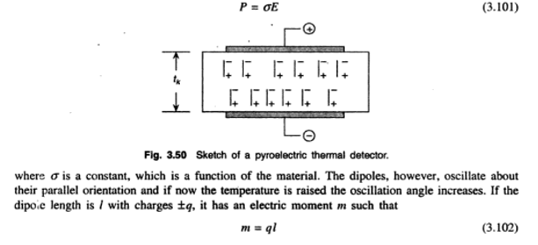


When a slice of pyroelectric ceramic is placed between a pair of electrodes and the electrodes given an electric field, with its temperature raised above Curie point, the molecules in the material orient themselves in the direction parallel to the applied field with opposite polarity of the dipoles.
This state, however, persists even when the field is removed (see Fig. 3.50). The amount of polarization thus affected is proportional to the applied field. Thus, if P is the polarization and E, is the applied field, then

Slide 5
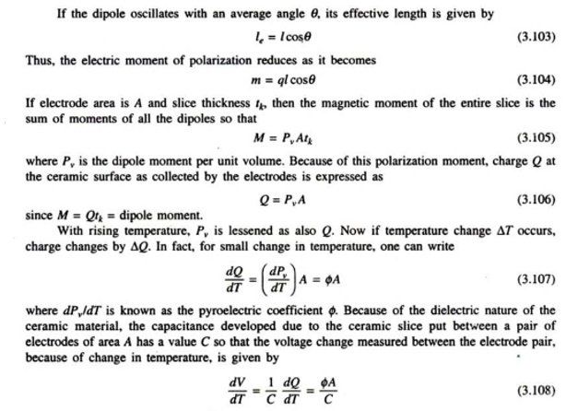



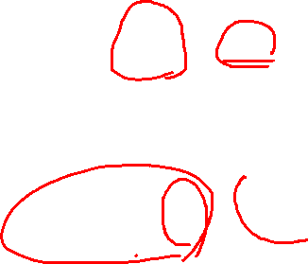

Slide 6
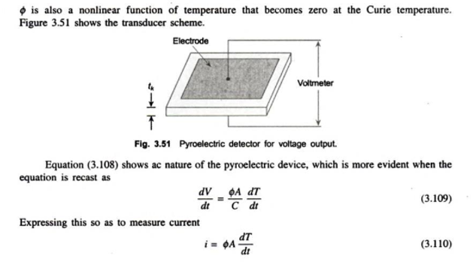


Slide 7
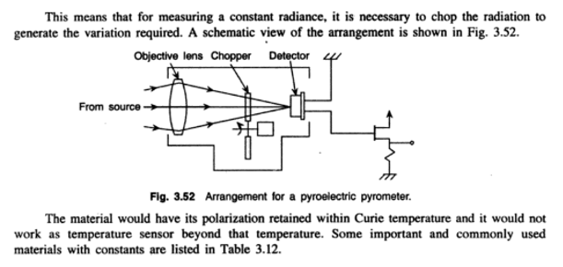
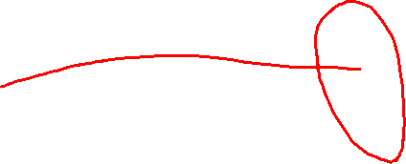

Slide 8
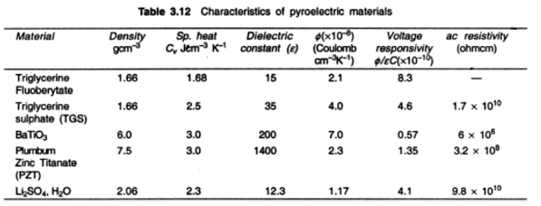

Slide 9
